Slide 1


Beer Data Analysis
Analyzing Beer data and creating a machine learning algorithm to help users decide which beer they should get based on their taste preferences.

Slide 2




The Team
<- Timothy Malasky
github.com/Tmalasky
<- Jack Moletteire
github.com/jmoletteire
<- Souleymane Ndiaye
github.com/muurid1

Slide 3
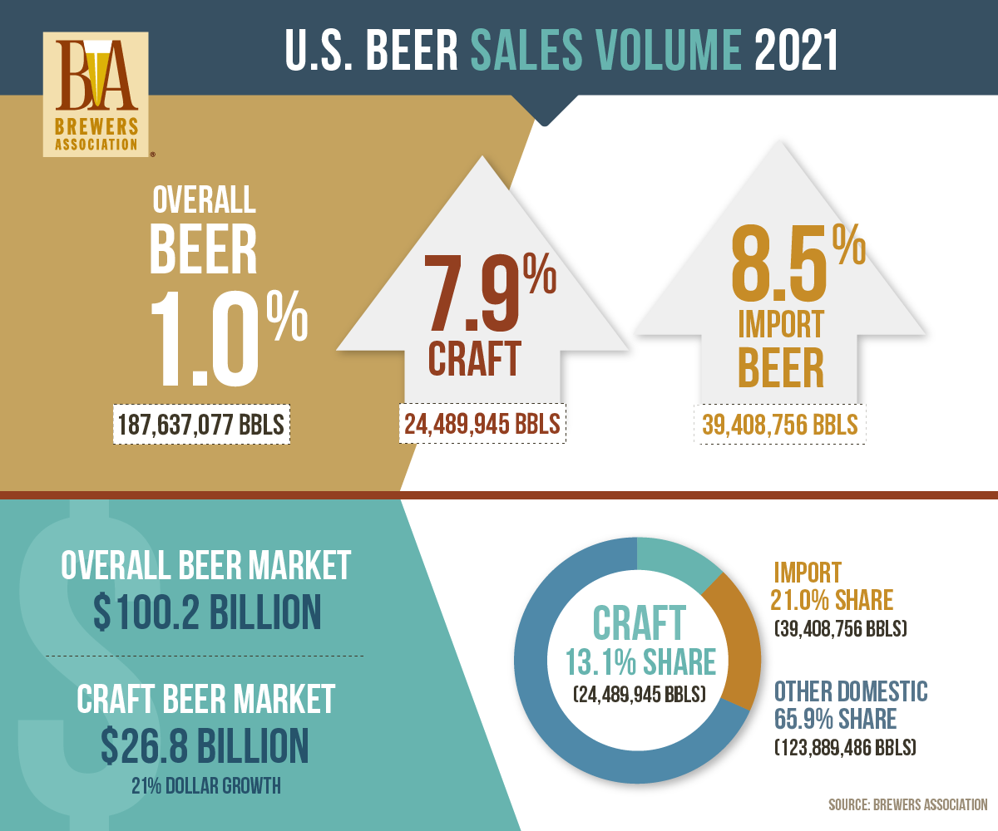
Why Beer?
Craft beer is increasingly demanded by consumers in today’s market.
Consumers’ willingness to spend more on craft beer based on variety, flavor and quality has increased since its beginnings in the 1960s.
Craft beer is typically made with higher quality ingredients, which provides consumers with a more flavorful and distinctive tasting beer than mass-produced options.
Those reaching for a craft beer often want something new.

Slide 4

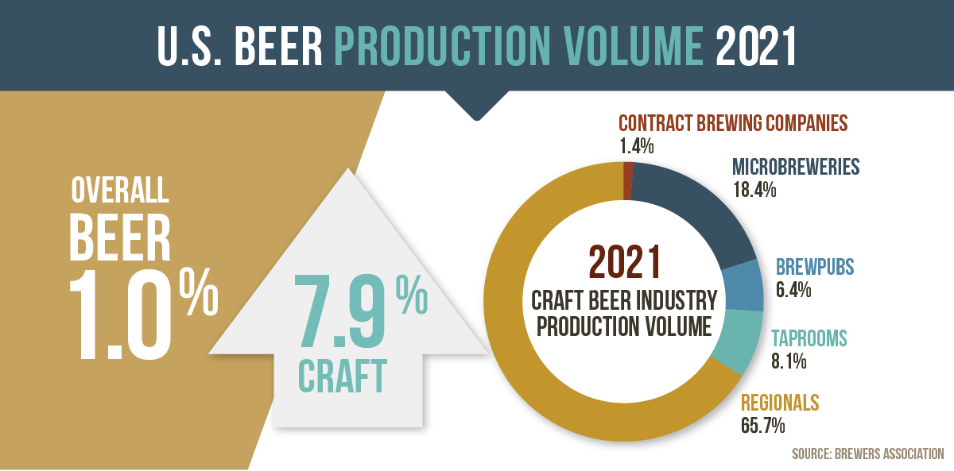
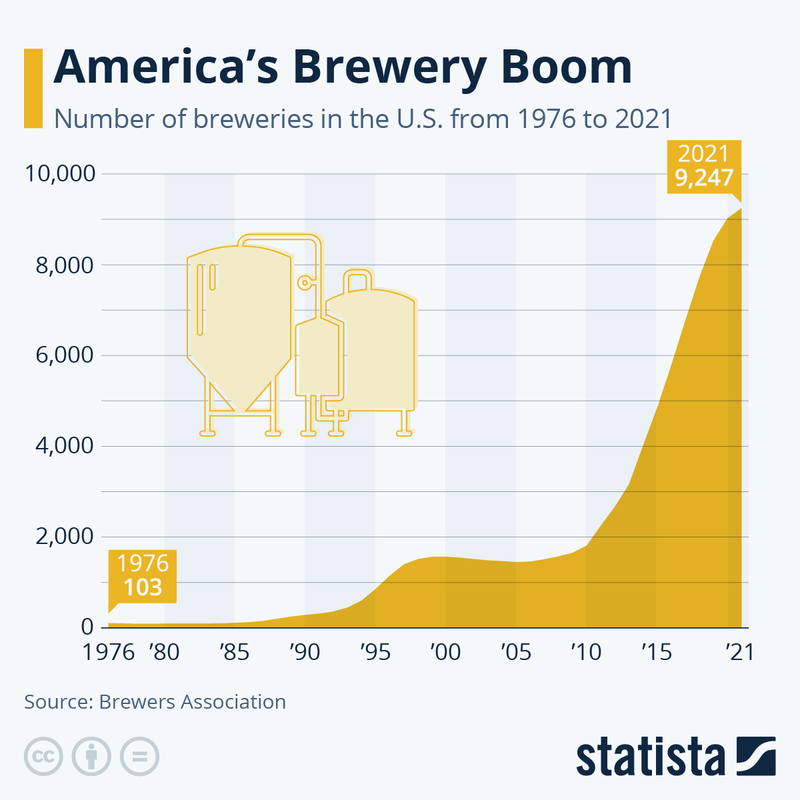
Craft Beer Trending Up in America every year
The First graph shows U.S. Beer Production Volume in 2021 based on breweries.
The Second graph shows the number of breweries in the U.S. each year since 1976.

Slide 5

But how to choose?
With so many beers and breweries to choose from, how can anyone decide on just one?
We studied a dataset to find the best beers and breweries as rated by real beer-drinkers, then created a machine-learning algorithm to answer everyone’s biggest question, “Which beer should I get?”

Slide 6
Database
The database we are using is from Kaggle and is a Beer Profile and Ratings Data Set.
The Database lists the name and style of beer and is broken down by different descriptors, which we use in our recommender system to determine the right beer just for you!
The Database also lists average user ratings for aroma, appearance, palate, taste, and overall rating of each beer.

Slide 7








Software and Technologies
Python
Pandas Library
Machine Learning Algorithm – Scikit-Learn
PowerPoint
Tableau Public
SQLite
CSS
HTML

Slide 8
Machine Learning
We built a multi-class classification model that analyzes user preferences to determine preferred beer style and make recommendations.
Preliminary analysis and preprocessing involved analyzing variables and grouping related data. A SQLite database was created to store several tables of related information.
The model was trained on beer taste profile (e.g., Astringency, Bitterness, Saltiness, etc.) and chemical composition (ABV, min./max. IBU) would be considered in the construction of the model, while more opinionated statistics like review scores, were excluded.

Slide 9
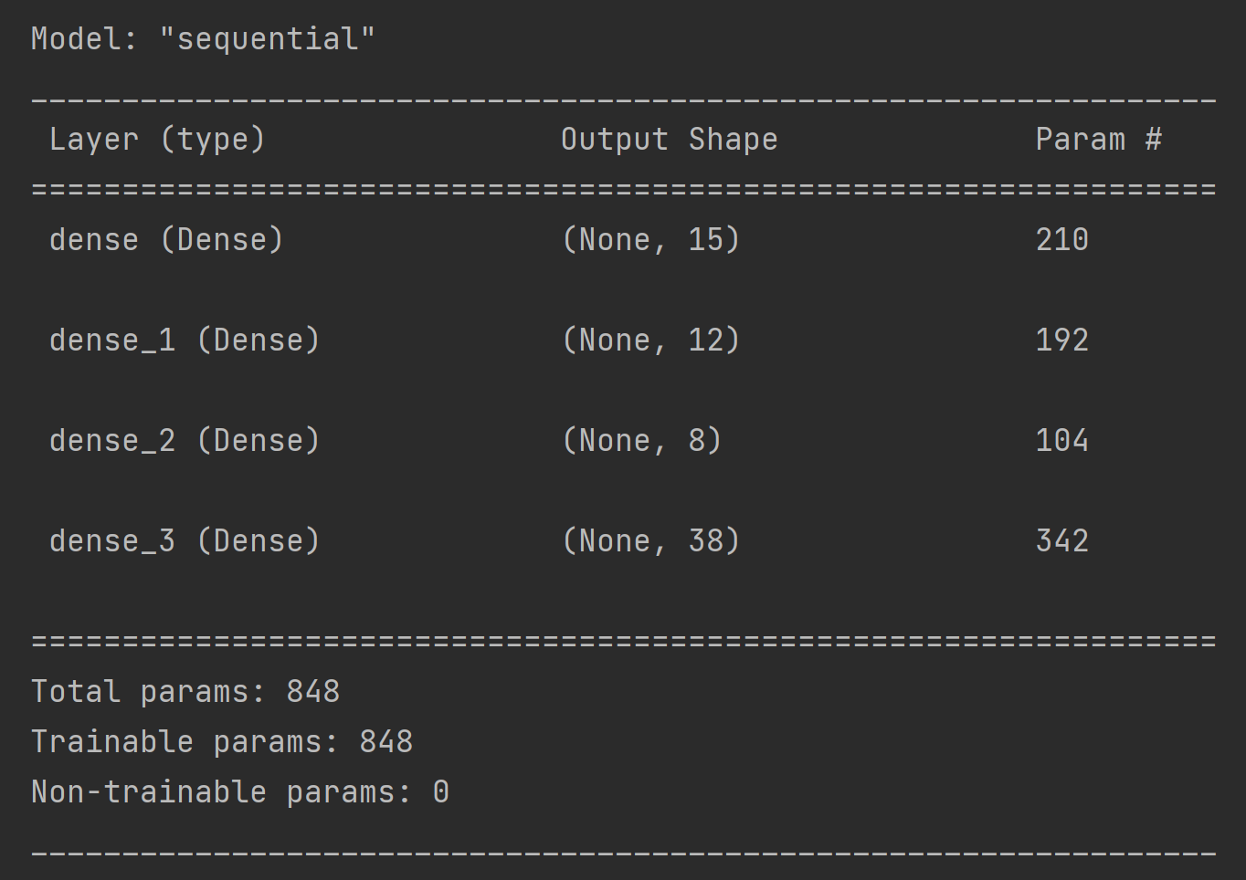
The Model

Slide 10
Confusion Matrix

Slide 11
Questions for our Dataset
What style of beer is most popular based on data from consumers?
Which flavor profile is most popular based on the dataset?
What type of beer you might prefer based on your input of type of taste preferences?
Which breweries have the most popular beers based on reviews?

Slide 12
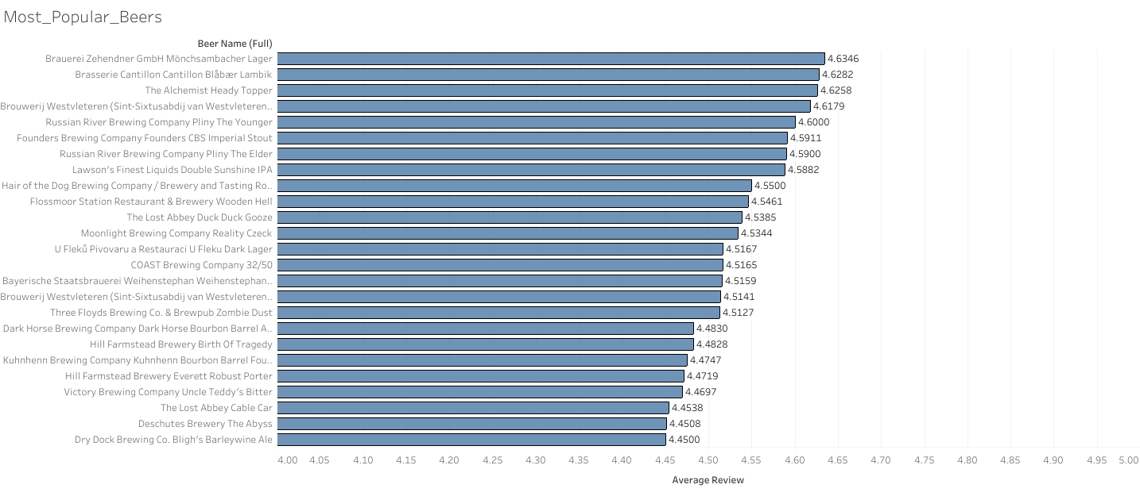
Most Popular Beers based on User Reviews
Highest Rated Beers by Overall Review score using a 1–5 point scale. Showing the top 25 in this category.

Slide 13
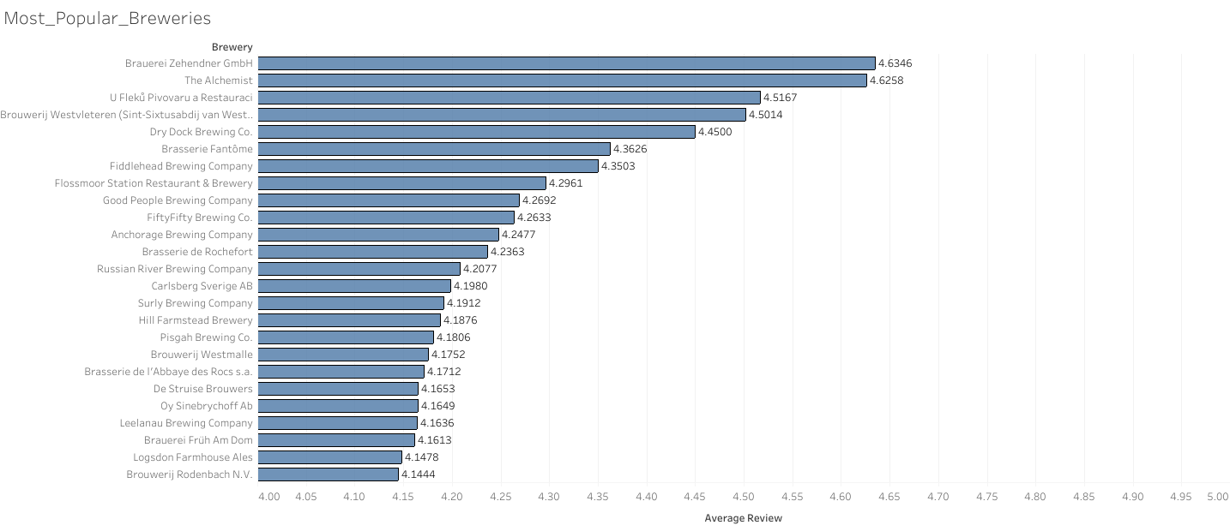
Most Popular Breweries based on User Reviews
Highest Rated Breweries by Overall Review score using a 1-5 point scale. Showing the top 25 in this category.

Slide 14
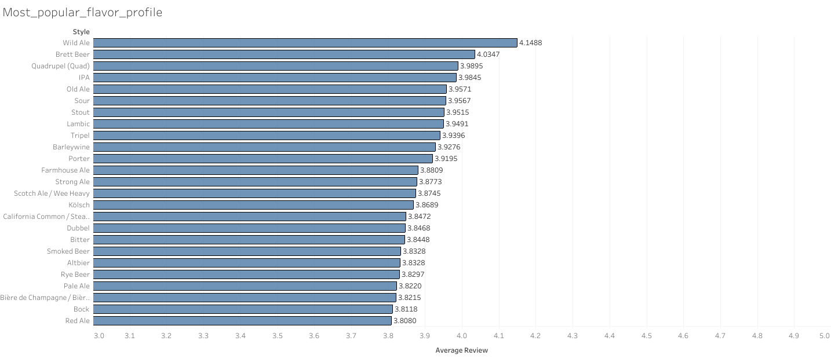
Most Popular Style based on User Reviews
Highest Rated Styles by Overall Review score using a 1-5 point scale. Showing the top 25 in this category.

Slide 15
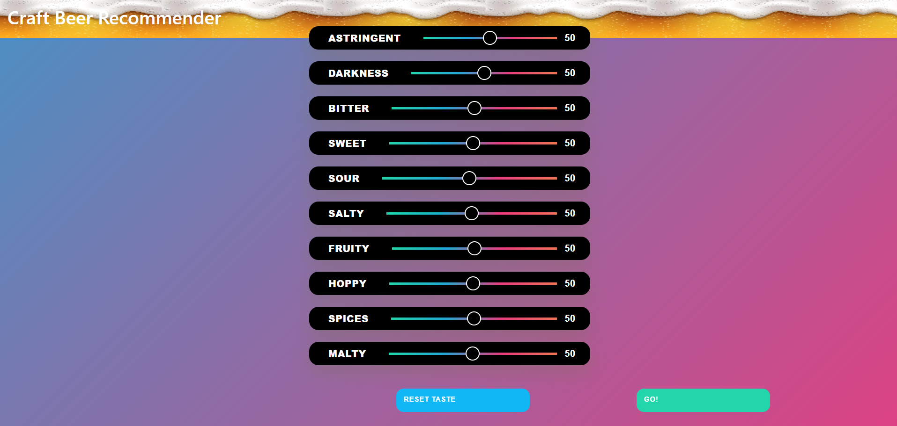
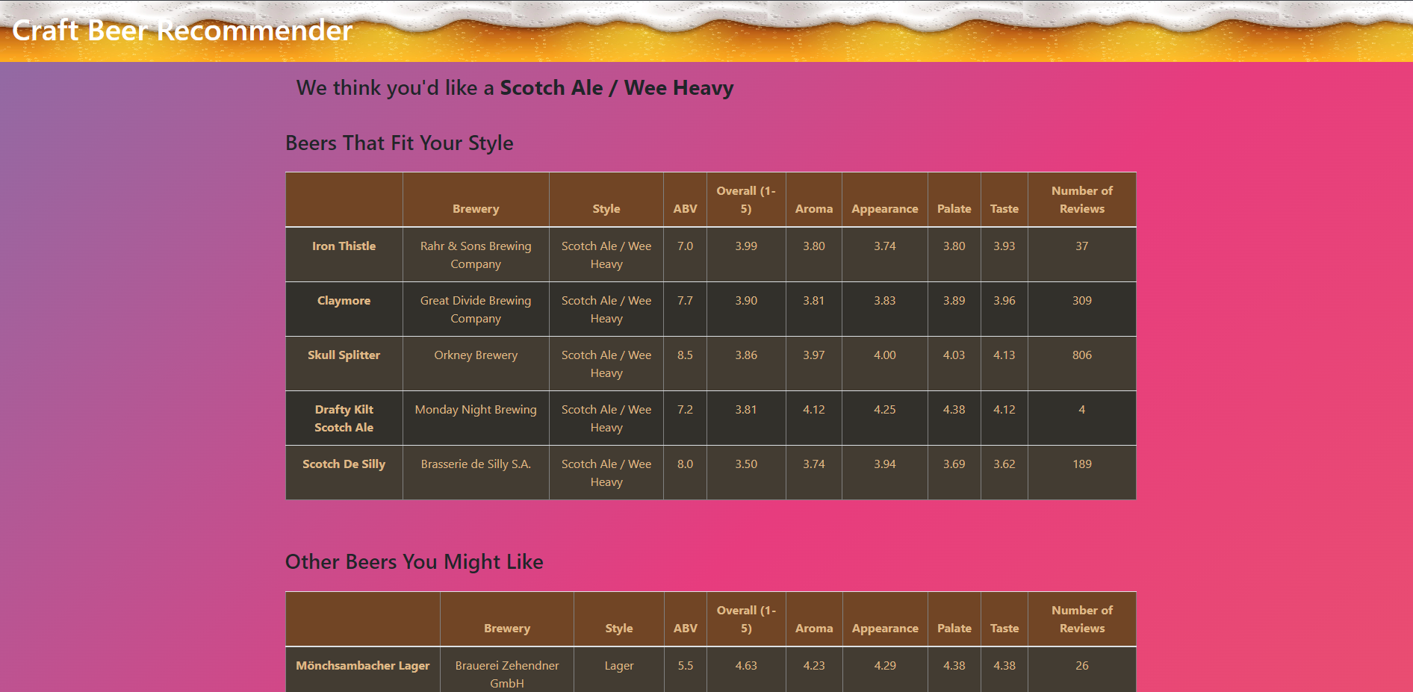
Beer Recommender Application
Flavor Profile Calculator
Results

Slide 16
Future Changes
Attempt to improve model accuracy.
Links to Beer and Brewery web pages.
Information and helpful hints for each taste category.
More readable formatting.

